Slide 1

BUYER & SELLER SEGMENTATION
PRESENTED BY: GROUP2 INTERNPULSE COHORT 5 November, 2024.

Slide 2
Project Overview
Objective
Develop personalized marketing strategies for buyers and sellers
Scope
Research and Data Collection
Data Analysis for Buyers and Sellers Segmentation
Creation of buyer and User Personas
Deliverables
Recommendations for Personalized Marketing Strategies

Slide 3
Objective
The global shift towards renewable energy has created new opportunities to connect buyers and sellers of innovative energy solutions.
This project aims to analyze user data to effectively categorize and target potential users of the platform, including both businesses and individual consumers interested in products such as solar panels, inverters, and wind turbines.
By segmenting users based on factors like location, age, and business type, this analysis will identify key customer groups and their specific needs.
The ultimate goal is to create detailed buyer and seller personas, such as "frequent buyers of solar panels by age and region" or "businesses specializing in high-capacity batteries."
These personas will help support personalized marketing strategies and drive platform growth.
Using data from surveys and online datasets, along with tools like Power BI, this project will provide a comprehensive overview of market trends, user preferences, and actionable recommendations to enhance platform targeting and improve user engagement.

Slide 4
Data Research and Collection
We collected data from survey and online sources
We used tools like Excel, Power BI for Data transformation & Analysis
Categorized users by Location, Age Range, Product Interest etc.
RENERGY HUB PROJECT\renewable_energy_multinational_dataset.csv

Slide 5
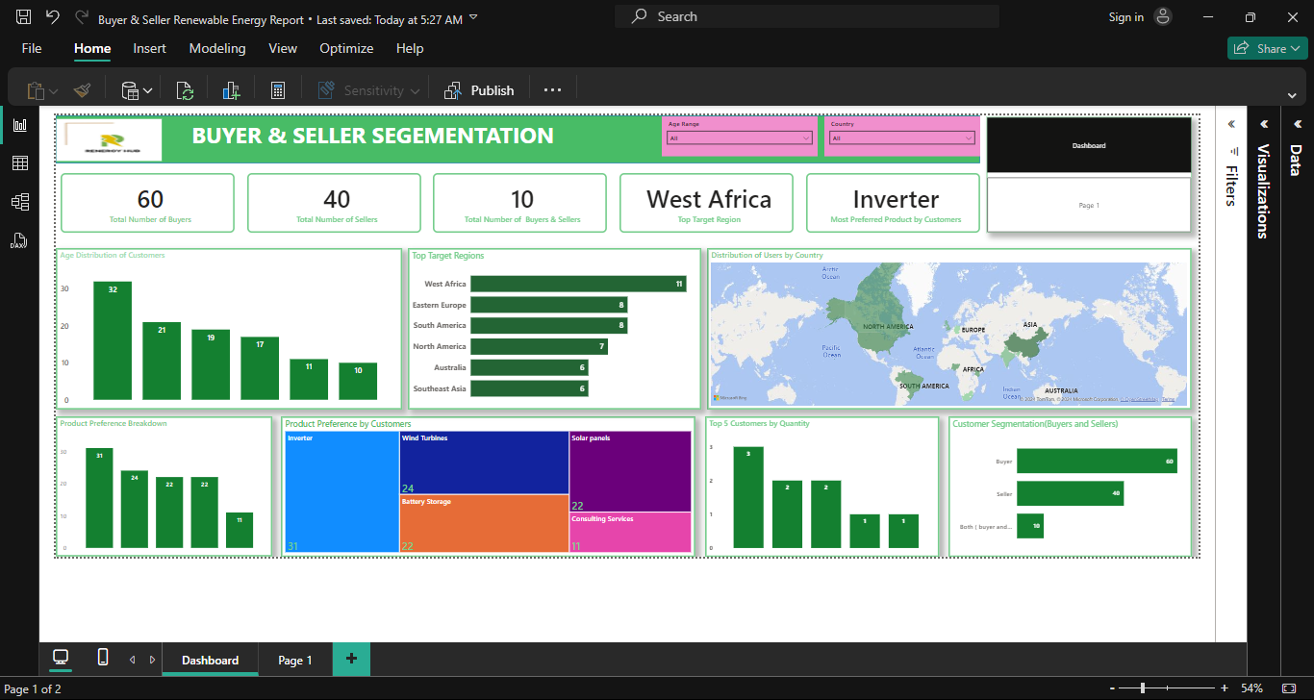
Overview of Dashboard
OVERVIEW OF DASHBOARD

Slide 6
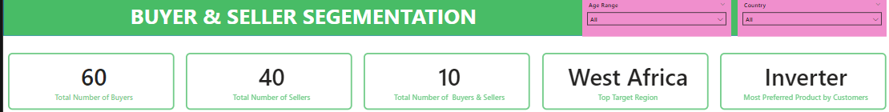
Key Metrics
Total Buyers and Sellers: The platform boasts a significant user base, with 60 active buyers and 40 active sellers. This balance indicates a thriving ecosystem for renewable energy products, as buyers are actively searching for innovative solutions while sellers offering a variety of product options.
Top Region: The data indicates that West Africa has the highest demand for renewable energy products. This insight suggests that we should prioritize our marketing and outreach efforts in this region, taking advantage of the growing interest in sustainable energy solutions.
Top Product: Among the wide array of offerings, inverters emerged as the most sought-after product. This indicates a strong market demand for efficient power storage and distribution systems, presenting an opportunity for sellers to focus on meeting this need.

Slide 7
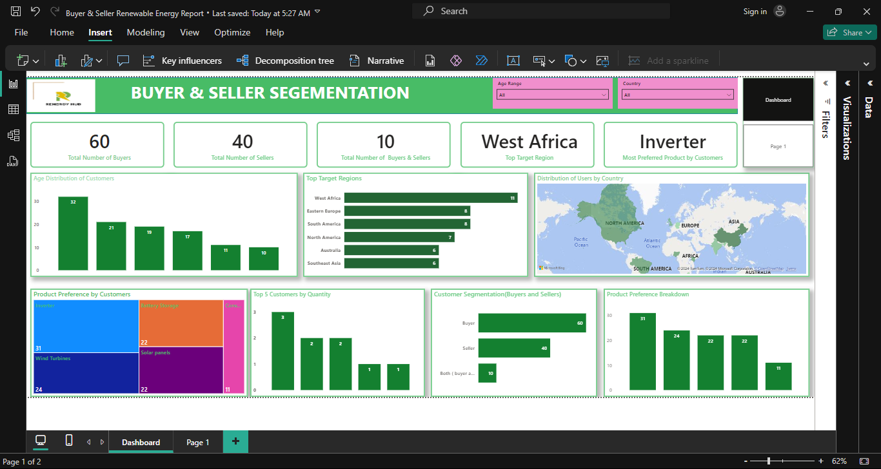
Demographics of Buyers and Sellers
Demographics of Buyers and Sellers 46–55 years: The largest segment, primarily sellers and buyers offering specialized products like wind turbines, solar panels, battery storage and consulting services.
56+ years: Experienced professionals and businesses focused on high-capacity solutions.
26–35 years: A mix of younger buyers and sellers, prioritizing affordable and scalable products like Wind Turbines, Battery storage and inverters.
18–25 years: Tech-savvy young buyers exploring sustainable energy for personal use or small startups.
36–45 years: The smallest segment, focused on mid-level business needs and partnerships.

Slide 8
Geographical Spread
Our analysis reveals the top regions driving the renewable energy market, providing a clear direction for prioritizing marketing and product distribution efforts.
Observations
West Africa: The highest concentration of buyers and sellers, making it a prime target for boosting market activities. The region’s growing energy needs and interest in renewable solutions present a significant opportunity for expansion.
Eastern Europe: A strong emerging market with increasing adoption of renewable energy technologies, driven by government policies and environmental initiatives.
North America: A well-established market with a balanced mix of buyers and sellers, offering opportunities to deepen existing partnerships and scale operations.

Slide 9

Product Demand by Customer Segment
Understanding which products are in demand helps us align our offerings with customer needs. The treemap chart highlights key product preferences across all customer segments, providing valuable insights into the market trends.
Observations:
Inverters are the most in-demand product, appealing to both buyers and sellers due to their efficiency and adaptability for diverse energy needs.
Wind turbines rank second, particularly popular among sellers targeting large-scale renewable energy solutions.
Other notable products include battery storage systems and solar panels, which cater to environmentally conscious buyers and small-scale businesses.
Consulting services, though a smaller segment, indicate interest in expert guidance for implementing renewable energy projects.

Slide 10

"Buyer and Seller Personas".
1. Sandra Brown
Profile
- Name: Sandra
- Age: 56+
- Location: Nigeria
- Gender: Female
- Role: Buyer
- Occupation: Consultant
- Business Sector: Agriculture
- Product Interests: Battery Storage, Solar Panels, Inverters
- Target Regions: West Africa

Slide 11
Motivations and Goals
- Source reliable and sustainable energy solutions for agricultural applications.
- Contribute to eco-friendly practices within agriculture.
Challenges
- Finding affordable, durable energy solutions that meet agricultural needs.
- Building reliable supplier relationships for long-term projects.
Needs from Platform
- Access to a network of high-quality suppliers focusing on agricultural applications.
- Detailed product information and reviews to assess suitability.
Personalized Marketing Approach
- Highlight products emphasizing durability, efficiency, and compatibility with agricultural technology.
- Emphasize reviews, success stories, and performance metrics relevant to agricultural applications.

Slide 12
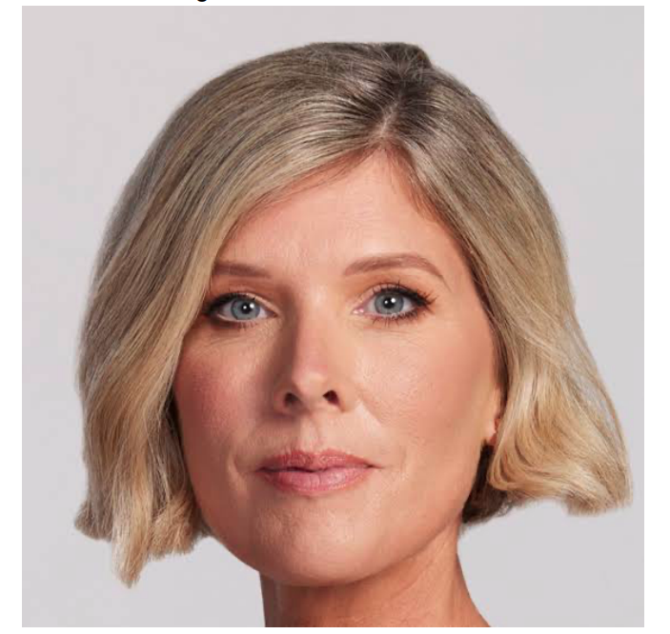
2. Rebecca Wright
Profile
- Name: Rebecca
- Age: 36-45
- Location: China
- Gender: Female
- Role: Buyer
- Occupation: Consultant
- Business Sector: Construction
- Product Interests: Solar Panels, Inverters
- Target Regions: South Asia

Slide 13
Motivations and Goals
- Secure high-efficiency solar panels and inverters for sustainable construction projects.
- Align energy solutions with modern construction standards and sustainability goals.
Challenges
- Meeting stringent energy standards for the construction industry.
- Navigating logistical challenges and import regulations in South Asia.
Needs from Platform
- Access to vendors with certifications and reliability for large-scale construction projects.
- Market insights on renewable energy standards in construction across South Asia.
Personalized Marketing Approach
- Highlight products with high efficiency and reliability that meet construction industry standards.
- Emphasize vendor certifications and customer success stories relevant to large-scale projects.

Slide 14

3. Gary White
Profile
- Name: Gary
- Age: 46-55
- Location: Kenya
- Gender: Male
- Role: Seller
- Occupation: Consultant
- Business Sector: Manufacturing
- Product Interests: Inverters
- Target Regions: Eastern Europe

Slide 15
Motivations and Goals
- Expand market reach in Eastern Europe through innovative inverter products.
- Strengthen reputation as a reliable consultant in the renewable energy field.
Challenges
- Competing with international manufacturers to ensure product competitiveness.
- Building a sustainable distribution network for efficient market penetration.
Needs from Platform
- Networking opportunities with buyers in Eastern Europe and access to detailed buyer profiles.
- Marketing resources and enhanced visibility within the European renewable energy market.
Personalized Marketing Approach
- Position Gary’s inverter products in competitive listings with emphasis on durability and efficiency.
- Showcase customer reviews and provide resources on European renewable energy trends.

Slide 16

4. Kenneth Larson
Profile
• Age: 26-35
• Location: Nigeria
• Gender: Male
• Role: Buyer • Occupation: Installer • Business Sector: Energy
• Product Interests: Inverters, Battery Storage
• Target Regions: Australia

Slide 17
Motivations and Goals
- Source high-quality inverters and energy storage solutions.
- Establish himself as a trusted installer in Australia.
Challenges
- Ensure compliance with Australian energy standards.
- Build client trust in a competitive environment.
Needs from Platform
- Connect with reputable sellers familiar with Australian regulations.
- Access technical specifications and product certifications.
Personalized Marketing Approach
- Highlight product certifications and compliance with Australian standards.
- Emphasize quality assurance and share success stories of other installers.

Slide 18
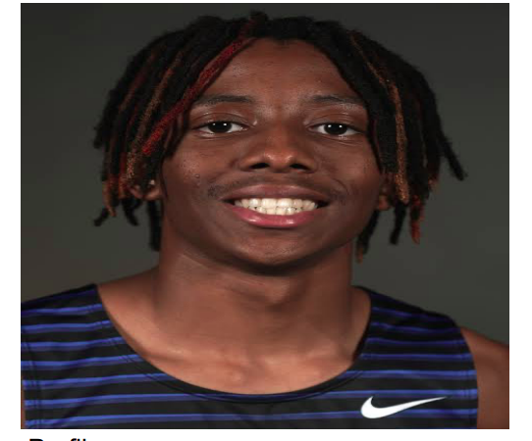
5. Jason Wells
Profile
● Age:18-25
● Location: Canada
● Gender: Male
● Role: Seller
● Occupation: Energy Consultant
● Business Sector: Renewable Energy Equipment
● Product Interests: Wind turbines and solar panels
● Target Regions: East Africa

Slide 19
Motivations and Goals
- Staying updated on renewable energy technology trends.
- Expand network of reliable suppliers for renewable equipment.
- Deliver cost-effective, efficient solutions to clients.
Challenges
- Market Saturation: Differentiating in a competitive market.
- Regulatory Hurdles: Navigating international energy policies..
Needs from the Platform
- Access to reliable vendors for renewable energy equipment.
- Tools for comparing product prices, specifications, and performance.
- Regular updates on trends, regulations, and innovations.
- Customer engagement tools for showcasing projects and gathering feedback.
Personalized Marketing Approach
- Share industry case studies and tailored guides.
- Showcase suppliers of large-scale equipment and offer exclusive discounts.

Slide 20
RECOMMENDATION
Based on our findings, here are actionable steps to move forward effectively:
Focus on High-Demand Regions: Target regions like West Africa, Eastern Europe, and North America with tailored marketing strategies to maximize engagement and sales.
Prioritize Top Products: Concentrate on promoting inverters and wind turbines, as they are the most in-demand products, especially in key markets.
Tailor Marketing by Age Group:
For younger buyers (18–35): Use social media and digital platforms to showcase affordable and innovative solutions.
For older professionals (46+): Highlight expertise, reliability, and premium products like wind turbines and consultancy services.
Leverage Data Insights: Use detailed personas and regional trends to personalize outreach and ensure products meet specific customer needs.
Expand into Emerging Markets: Explore opportunities in regions with growing interest, like parts of Asia and Africa, to tap into future demand.
Strengthen Buyer-Seller Ecosystem: Encourage partnerships between buyers and sellers, offering incentives like discounts for bulk purchases or loyalty rewards for repeat customers.

Slide 21



Meet the Team
Blessing Ugochi Godwin
Justus E. Ajaegbu
Tafadzwa Chivasa

Slide 22
THANK YOU!

